Slide 1
Sentimental analysis for Drug data set
Name of the student:
Aya Salem ID:13482453

Slide 2
Section 1 Data description:
Used !wget to explore my data set.
The drug review data set is taken from the UCI machine learning repository. This data set provides patient reviews of specific drugs and related conditions and 10-star patient ratings that reflect overall patient satisfaction. This data was obtained by scraping online drug review sites. The shape of the drug review data set is (161297, 7), which means it has 7 features, including review and 161297 data points or entries.
• The features are 'drugName' which is the name of the drug, 'condition' which is the condition the patient is suffering from, 'review' is the patients review, 'rating' is the 10-star patient rating for the drug, 'date' is the date of the entry and the 'usefulcount' is the number of users who found the review useful.
• Here the sentiment of the review is the target variable that needs to be predicted. here we can notice that the sentiment of any review is not given, so we have to give the sentiment to the rating first and then use it as the target variable.

Slide 3
Section 2 Problem(s) statment: Description of the problem(s) or question(s) to be answered:
* Train and test datasets have no null values for all the columns except for the condition column so we will delete the rows that contains null values first ,because we don't need to fill the null values to guarantee the reliability and quality of the data Second the number of rows with null values is negligible compared to the size of the dataset of the train and test set¶
* condition is a field which present problems in 900 registers, probably due to some bug in the data web scraping. The value of those registers is the usefulCount value with an span HTML tag and the following text: "users found this comment helpful". We will delete these registers.
* We have to predict the sentiment of the patients :we created a new column called Review_Sentiment

Slide 4
Section 3 Technical information: List of the packages and statistical tools to use.
short description of each package and tools:
Wordcloud: Word Cloud is a data visualization technique used for representing text data in which the size of each word indicates its frequency or importance.
Nltk: The Natural Language Toolkit (NLTK) is a Python package for natural language processing.
Tqdm:means "progress" in Arabic (taqadum, تقدّم) and is an abbreviation for "I love you so much" in Spanish (te quiero demasiado).
Instantly make your loops show a smart progress meter
Pandas: pandas is a fast, powerful, flexible and easy to use open source data analysis and manipulation tool
Sklearn:Scikit-learn is a free machine learning library for Python. It features various algorithms like support vector machine, random forests, and k-neighbours
Seaborn:Seaborn is a Python data visualization library based on matplotlib. It provides a high-level interface for drawing attractive and informative statistical graphics.

Slide 5
Tools:
Word cloud:
Bar graph:
Donut chart:
Count plot:
Pie chart
Graph of distribution.
TF-IDF vectorization
Random Forest

Slide 6
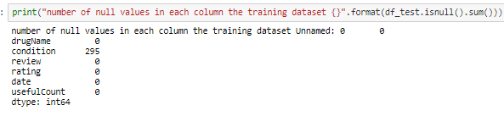
Section 4 : Performing the analysis: Include the codes and interpret the results.
Train and test datasets have no null values for all the columns except for the condition column so we will delete the rows that contains null values first ,because we don't need to fill the null values to guarantee the reliability and quality of the data Second the number of rows with null values is negligible compared to the size of the dataset of the train and test set¶

Slide 7
condition is a field which present problems in 900 registers, probably due to some bug in the data web scraping. The value of those registers is the usefulCount value with an span HTML tag and the following text: "users found this comment helpful". We will delete these registers.

Slide 8
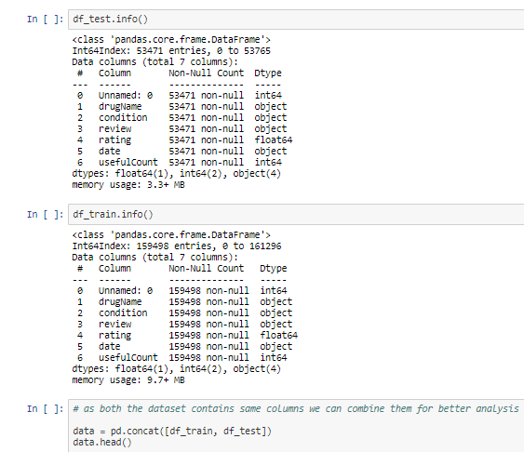
Descriptive Statistics

Slide 9
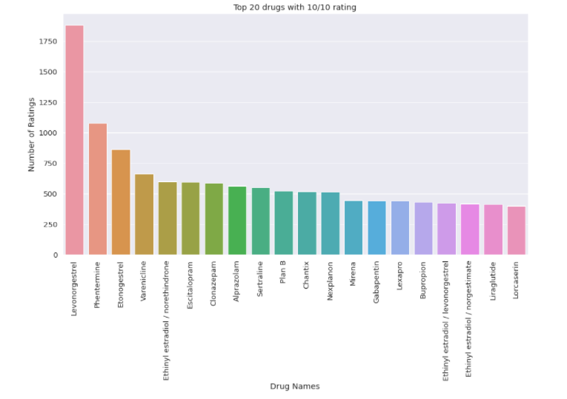
The is a bar graph which shows the top 20 drugs given in the data set with a rating of 10/10. 'Levonorgestrel' is the drug with the highest number of 10/10 ratings, about 1883 Ratings in the data set for 'Levonorgestrel'.

Slide 10
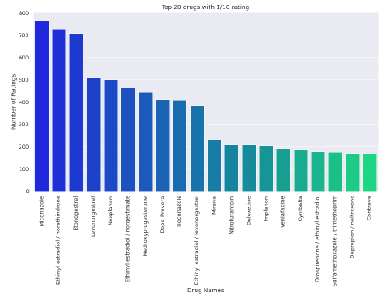
• The is a bar graph that’s hows the top 20 drugs given in the data set with a rating of 1/10. 'Miconazole' is the drug with the highest number of 1/10 ratings, about 767.

Slide 11
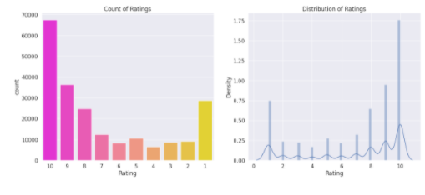
The shows a distribution plot on the right hand side and a bar graph of the same on the left hand side. This shows the distribution of the ratings from 1 to 10 in the data set.
• bar plot show the top 10 conditions the people are suffering.

Slide 12
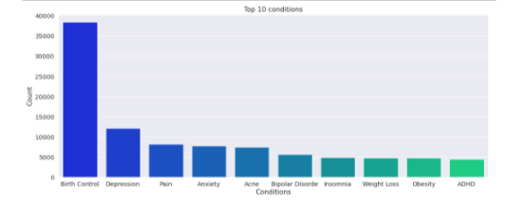
The is a bar graph which exhibits the top 10 conditions the people are suffering from. In this data set 'Birth Control' is the most prominent condition by a very big margin followed by Depression and pain.
• Top 10 drugs which are used for the top condition, that is Birth Control

Slide 13
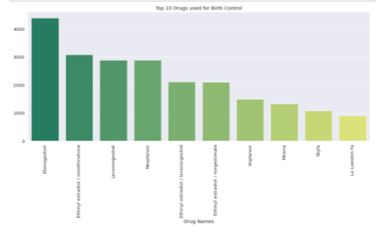
The is a bar graph which exhibits the top 10 drug names for the people suffering from Birth Control. In this data set 'Etonogestrel' is the most prominent drug by a very big margin.
• the words cloud for the reviews

Slide 14
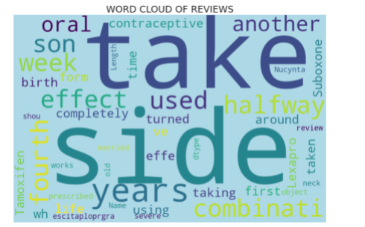
to predict the sentiment of the patients we need to create a new column called Review Sentiment where the sentiment is positive when the review is > 5 else it will be negative.

Slide 15
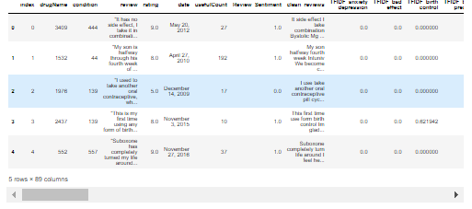
• to have a good result we will use TextBlob sentiment analyses feature.
• TextBlob is a Python (2 and 3) library for processing textual data. It provides a simple API for diving into common natural language processing (NLP) tasks such as part-of-speech tagging, noun phrase extraction, sentiment analysis, classification, translation, and more.
• The sentiment property returns a namedtuple of the form Sentiment(polarity, subjectivity).
• Polarity is float which lies in the range of [-1,1] where 1 means positive statement and -1 means a negative statement.

Slide 16
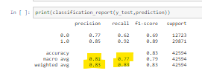
Section 5 Conclusion:
precision>>

